Slide 1
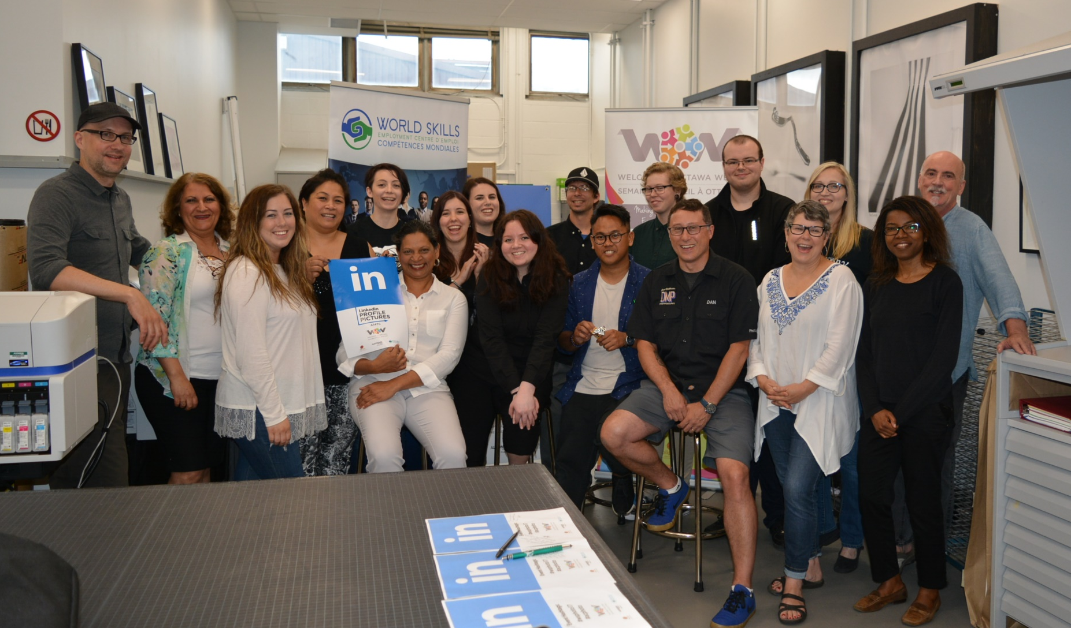
Thank you #acphoto for a great LinkedIn Profile Session!

